Slide 1
Data 607 Final Project- Involuntary Psychiatric Hospitalization Rates in New York
Benjamin Bravo

Slide 2
Introduction
This project analyzes psychiatric hospitalization patterns in New York City as a way to understand where emergency or involuntary mental health intervention may be most needed. Psychiatric hospitalization is important because it can indicate severe mental health crises where a person may be at risk of harm to themselves or others. Although hospitalization can provide immediate safety and stabilization, high hospitalization rates may also show gaps in outpatient care, crisis response, housing support, and preventive mental health services.
Main Research Question: Do psychiatric hospitalization rates differ by community and demographic factors, and how can this information benefit the community?
Hypothesis: Communities with higher poverty levels and groups with less access to preventive mental health care will experience higher psychiatric hospitalization rates. Identifying these patterns can help public health officials better target crisis teams, outpatient programs, and community support services.

Slide 3
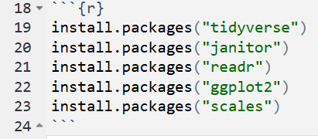

Packages Installed
Tidyverse
Janitor
Readr
Ggplot2
Scales

Slide 4

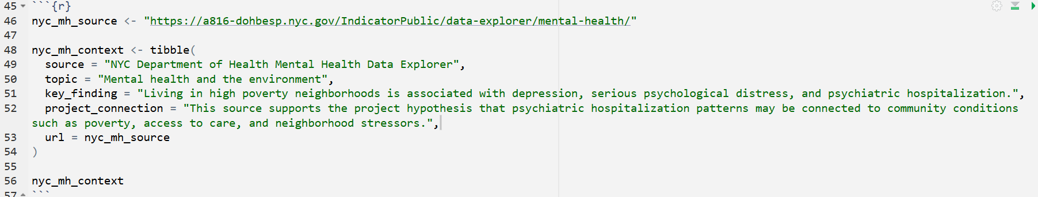
Data Sources
https://health.data.ny.gov/resource/46xm-urtu.csv?$limit=50000
https://a816-dohbesp.nyc.gov/IndicatorPublic/data-explorer/mental-health/

Slide 5
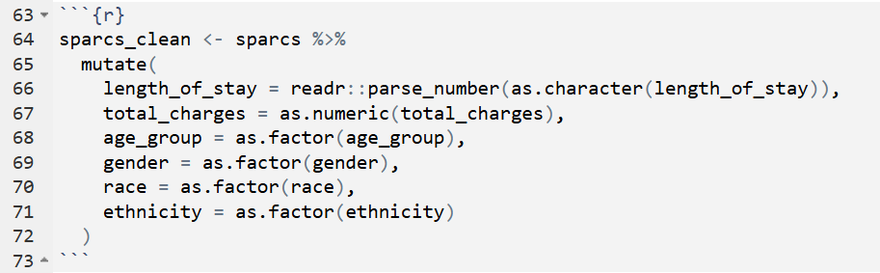
Data Cleaning and Transformation

Slide 6
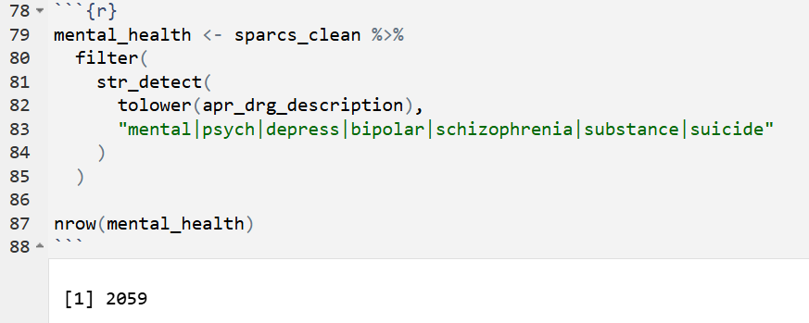
Mental Health-Related Hospitalizations

Slide 7

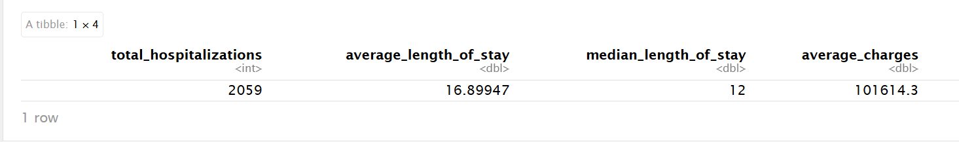
Summary Statistics

Slide 8
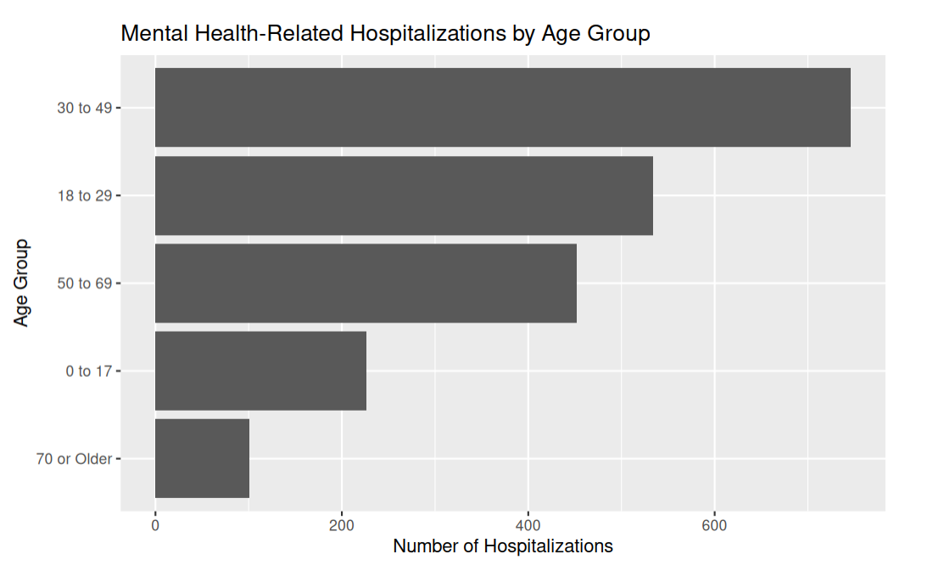
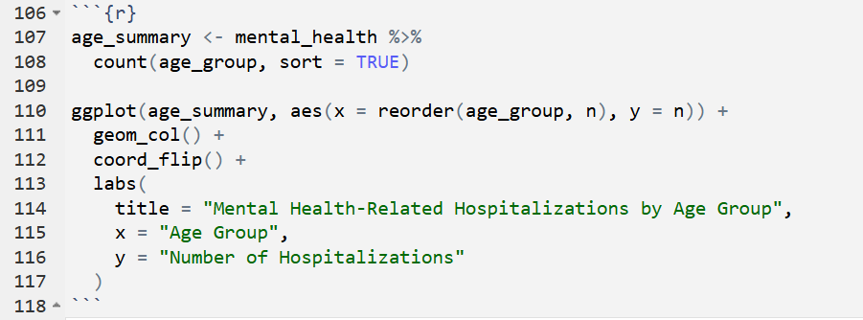
Hospitalizations by Age Group

Slide 9
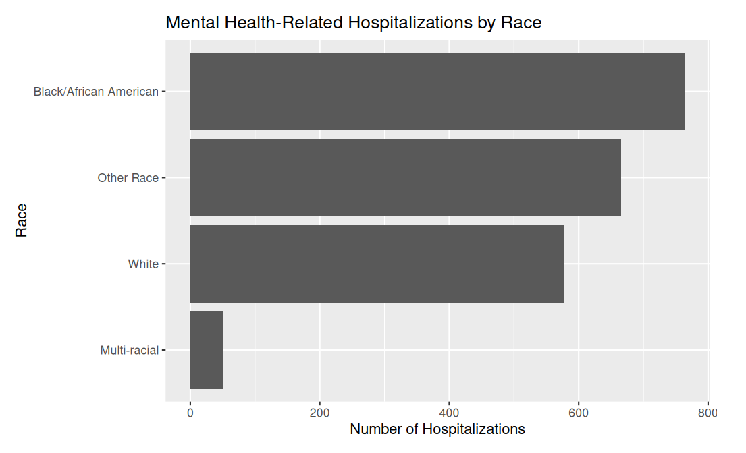

Hospitalizations by Race

Slide 10
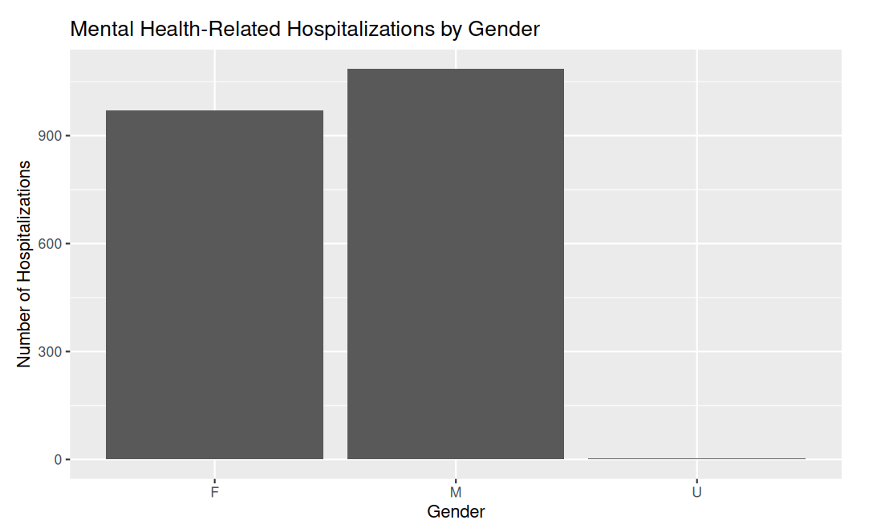

Hospitalizations by Gender

Slide 11
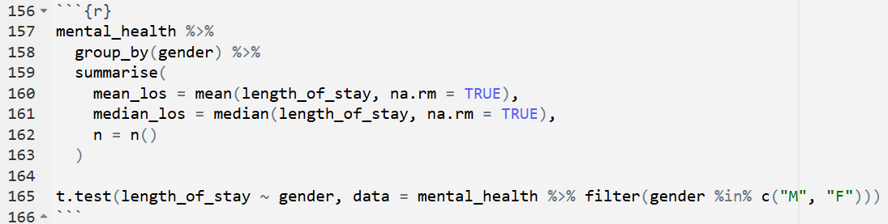
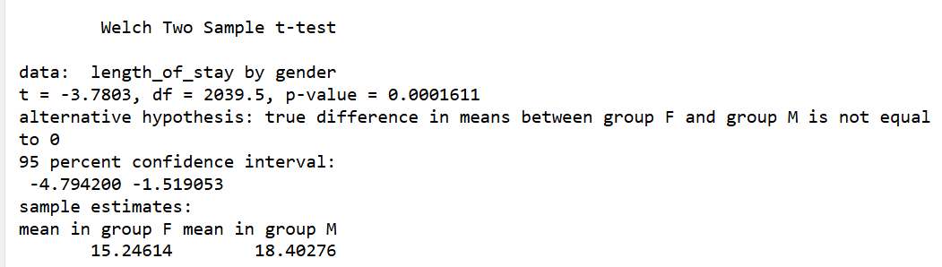
Statistical Analysis: Length of Stay by Gender

Slide 12
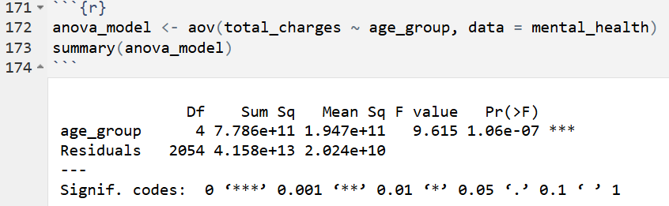
Statistical Analysis: Charges by Age Group

Slide 13

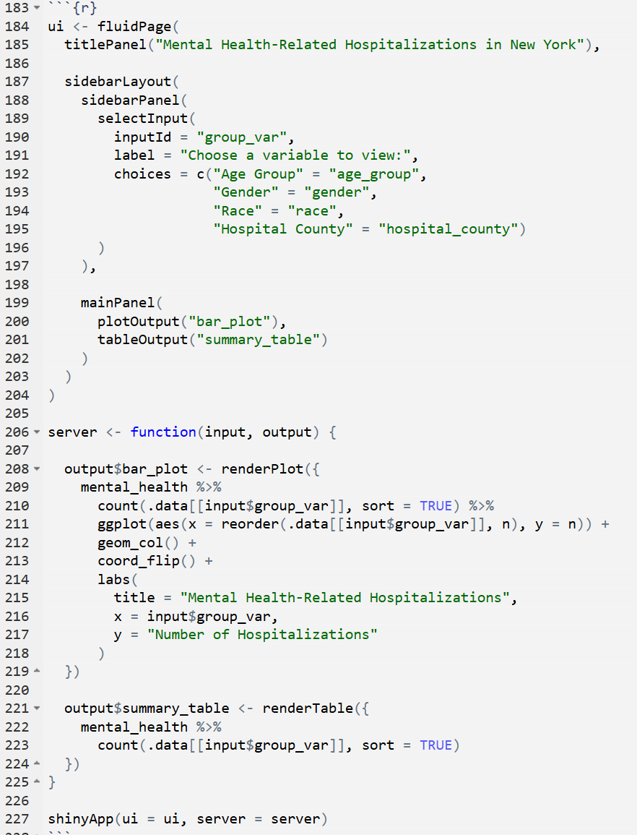
Dashboard-Code

Slide 14
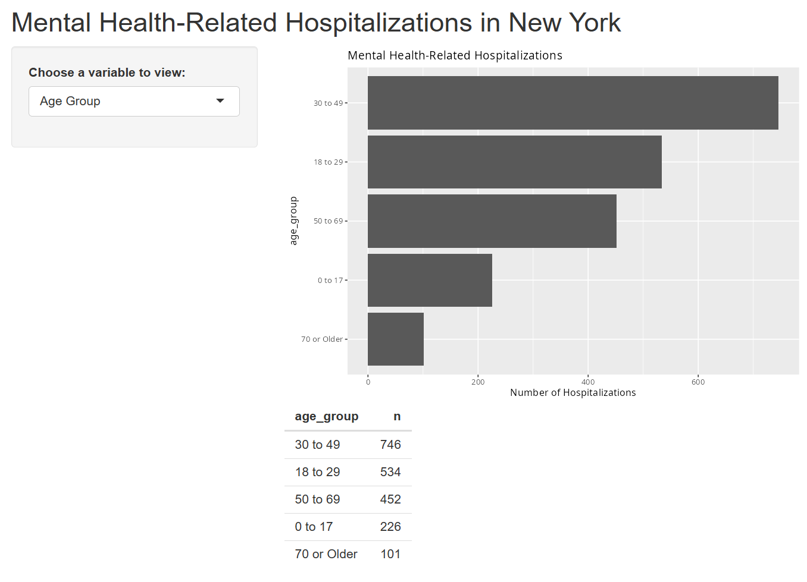
Dashboard

Slide 15
Community Benefit Interpretation
Over 2,000 mental health-related hospitalizations were identified in New York, with an average hospital stay of about 17 days, showing the seriousness of psychiatric crises.
Adults ages 30–49 had the highest hospitalization rates, and Black/African American patients represented one of the largest groups in the data.
Male patients stayed in the hospital longer on average than female patients, and statistical testing showed this difference was significant.
The findings suggest that communities may benefit from stronger mental health support systems, including crisis intervention programs, outpatient care, supportive housing, and early prevention services.

Slide 16
Conclusion
The project analyzed psychiatric hospitalization patterns in New York using SPARCS hospital discharge data and statistical analysis to better understand mental health crises across demographic groups.
Adults ages 30–49 had the highest hospitalization rates, male patients had longer hospital stays, and hospital charges differed significantly across age groups.
A second data source from the NYC Department of Health helped explain how factors such as poverty, stress, housing instability, limited healthcare access, and substance use may contribute to mental health crises in different communities.
Combining hospital data with public health data showed how healthcare analytics can help identify communities that may benefit from stronger mental health services, prevention programs, and crisis intervention support.

Slide 17
Challenges Encountered
One major challenge was cleaning and preparing a large real-world healthcare dataset before analysis could begin.
Some variables were stored in the wrong format, such as numbers saved as text, which caused errors during calculations and statistical testing.
The dataset also had unexpected or changed variable names, requiring the code to be adjusted after checking the dataset structure.
The dataset did not directly identify whether hospitalizations were voluntary or involuntary, so the project focused more broadly on psychiatric hospitalizations as indicators of severe mental health crises.

Slide 18
New Feature Not Covered in Class- Shiny Dashboard
A new feature added to the project was an interactive Shiny dashboard that allows users to explore hospitalization trends by age group, gender, race, and hospital county.
The dashboard goes beyond static graphs because users can interact with the data and choose which variables they want to analyze.
The project also involved working with a large real-world healthcare dataset containing inconsistent formatting, healthcare coding systems, and complex demographic information.
Multiple data science techniques were combined in a public health setting, including data cleaning, transformation, visualization, statistical testing, and interpretation of healthcare trends to support community mental health planning.

